Slide 1

TICKETING APPLICATION FOR DEFECT MANAGEMENT

Slide 2

TEAM MEMBERS
Mittapalli Pavani
Pala Uma
Banu Sahthya Janga
Sukanya R
Sowjanya Pati

Slide 3
INTRODUCTION
A major test objective is to identify defects.
Defects are basically considered as destructive in all software development stages. Any unexpected things that occur in software stages are defective in that particular software.
To establish a defect management process is the most attractive and best way to increase and improve the quality of software. There is no such software that is present without any defect.

Slide 4
TABLE OF CONTENTS
Understanding The Problem Statement
Coding and Execution
Code Testing
4. Challenges Faced

Slide 5
Understanding the problem statement

Slide 6
Introduction To The Problem Statement
Defects are assigned to programmers depending on functional area.
Information available in multiple files, are need to passed to the applications as command line arguments.
Format the defect description files.
Programmers information is available in “employees.txt”file.
Open defects from defects file for every defect find programmer who is expert in defects functional area and change status of defect.
Invalid defect entries from all input files should be stored to invalidDefect.txt file
Display error message for invalid entries and those entries should be discarded .

Slide 7
FLOW CHAT
Invalid Defects
Write Invalid
Defects
No
Is Defect valid
Start
Defect Files
Read Defects
Yes
Programmers
Details
Read Programmers
Details
Programmers Data
Defect Details
Is there a programmer for the given Defect?
Unassigned Defects
Write Unassigned Defects
No
Yes
Printing the Details of Employee and Assigned Defects
Stop
Individual Employee File
Save Employee Data on File
Update Status of Defect Files

Slide 8
CODING AND EXECUTION

Slide 9
SYSTEM ARCHITECTURE
Input files
main.c
getdefect.c
assign.c
Output files

Slide 10
MUTEX SNAPSHOT

Slide 11
TESTING

Slide 12
FILES
defectID : description : moduleName : Functional Area: date : status : type
1. F001:Column values in BOM reports are incorrect:Aircraft design:BOM reports:21/08/2022:open:fatal
2. F002:Unit prices are not shown while preparing invoice:Invoices:Display products:23/04/2022:close:fatal
3. N001:BOM report columns not aligned properly:Aircraft design:BOM reports:21/08/2022:open:niceToHave
Defect.txt

Slide 13
EmployeeID : Name : Business Unit : Expertise : Designation
1. A123:Suresh Panchal:UK Telecom:BOM report:Principal engineer
2. D012:J K Laxmi:Finacle Systems:Display products:Junior programmer
3. C015:Sandeep Khaire:UK Telecom:Manage customers:Senior programmer
Employee.txt

Slide 14
DIFFERENT TYPES OF TEST CASES
➔ Less than or More than Actual Defect Attributes
➔ Less than or More than Actual Employee Attributes
➔ No Programmer is Found for Defect
➔ More than one Programmer is Found
➔ File is Empty or not Opening or Invalid file type
➔ Wrong Format of Defects or Employee in File
➔ Multiple Defect.txt Files
➔ Defect Status Close/Open Or Something else
➔ Defect With same Defect IDs
➔ Date Format is Wrong
➔ Space ‘ ‘ is Considered as Character EX:- : BOM report :--

Slide 15
INTEGRATIONTESTING OUTPUT

Slide 16
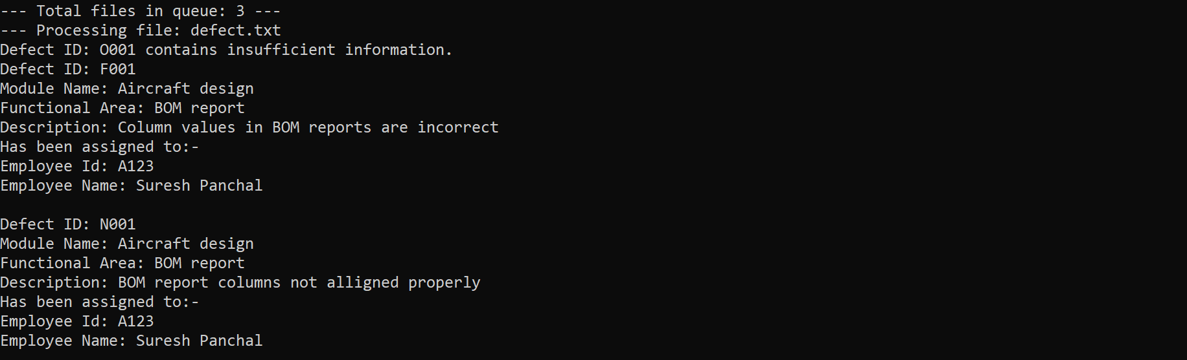
Testing output - 1

Slide 17
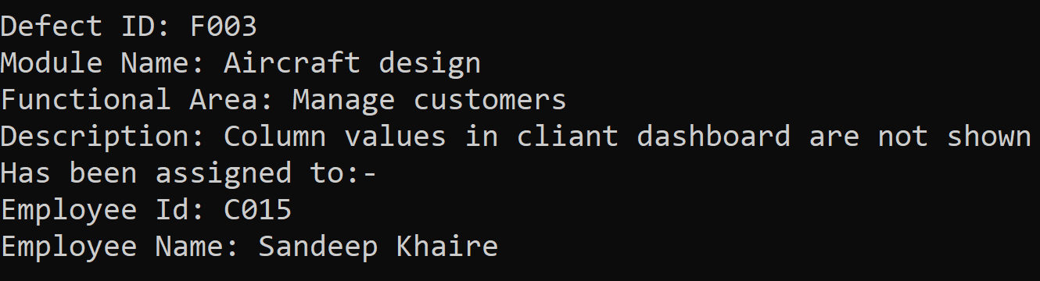
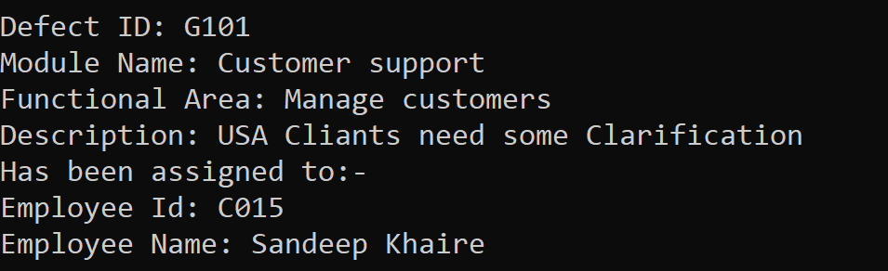
Testing output - 2

Slide 18
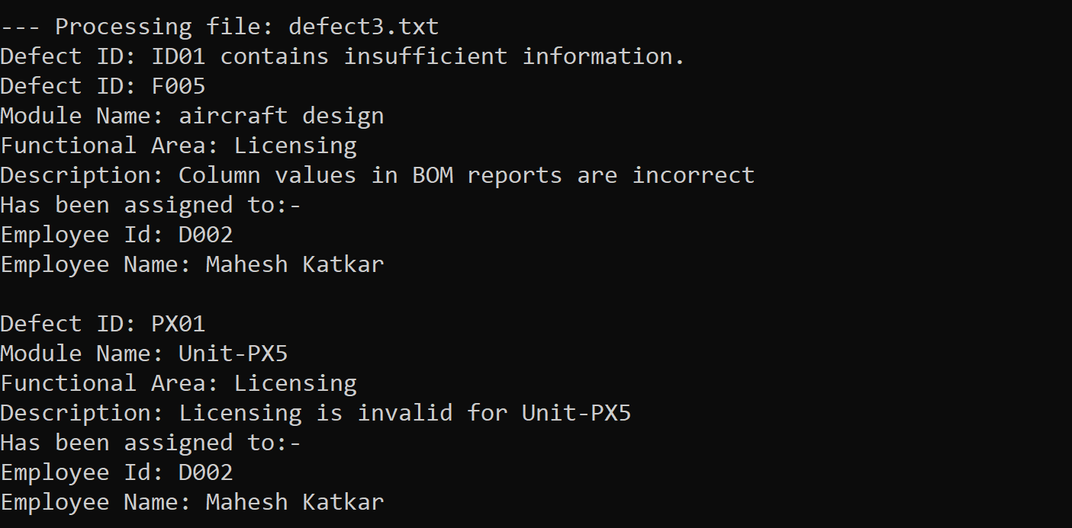
Testing output - 3

Slide 19
OVERVIEW
This project aims to develop a Defect Programmer Assignments application where clients of a Software Development company report defects in software they purchased.
These defects are assigned to programmers depending on the functional area they are handling

Slide 20
OBSTACLES

Slide 21
Challenges faced
To decide which data structure would be best for our project
Checking validity of the employee
Finding defect in the file from the program

Slide 22


